Slide 1
Predicting Big data USING OKCUPID DATABASE
Machine Learning Fundamentals
Ben Davis
3/19/2019

Slide 2
Table of contents
Adding new columns to explore the dataset (Slides 1-2)
Exploring the data of the new columns (Slides 3-4)
The Question (Slide 5)
Creating our prediction models (Slides 6-7)
Conclusion (Slide 8)

Slide 3
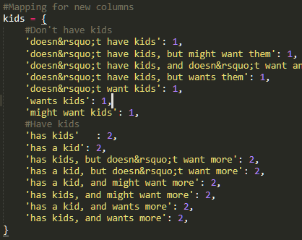
Adding new columns
To start exploring the dataset, we needed to add new columns with new values
To the left is the mapping for one of the new columns labeled ‘kids’ which will utilize the ‘offspring’ column
Each new label is a 1 or a 2
This is to differentiate which users have, or don’t have, offspring numerically
1 = Doesn’t have offspring
2 = Does have offspring

Slide 4
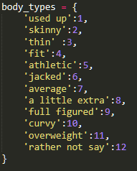
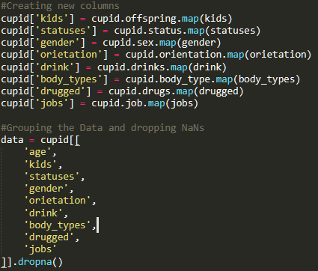
Creating new columns cont.
The top right picture seen is the mapping for the new ‘body type’ column
New numerical values were assigned
With numerical data, we can now use the data
more easily
The bottom left code snippet shows the creation of our new columns
Using the maps specified
Then grouping the data and removing all “NaN’s” so we don’t include users that didn’t input the data we want to use

Slide 5
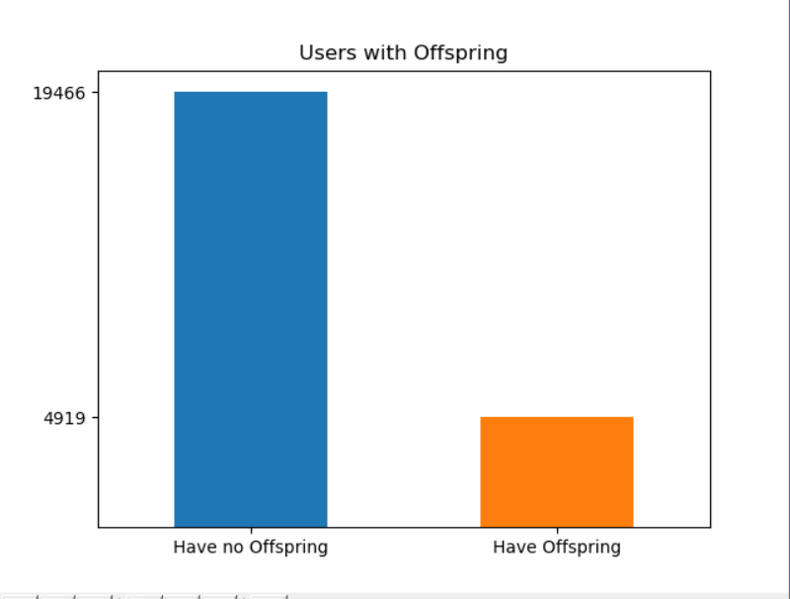
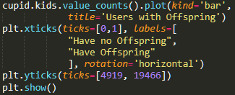
Exploring which users have offspring
Out of ~50,000 users from
the database
Only 4,919 have offspring
About half of all users did
not specify
How the graph was made
Using value counts from the new ‘kids’ column
Assigning labels for users with offspring and without offspring
To the bottom left you will see the code implemented

Slide 6
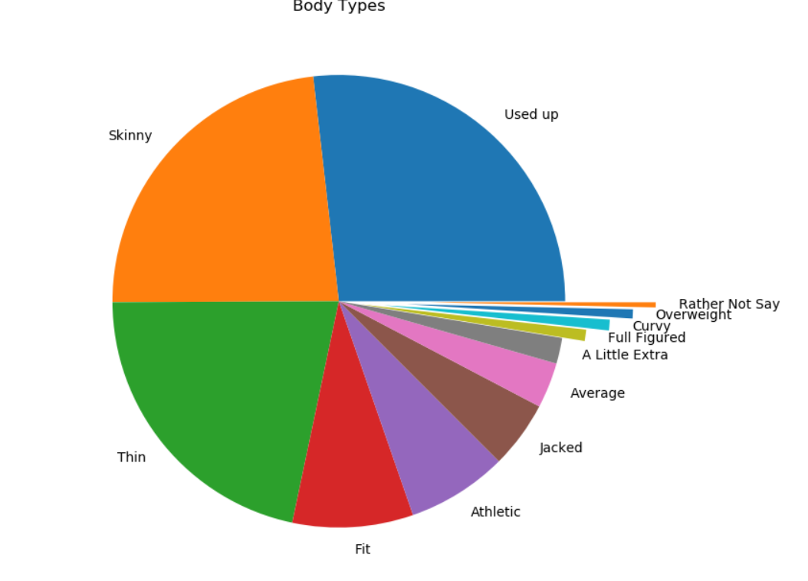
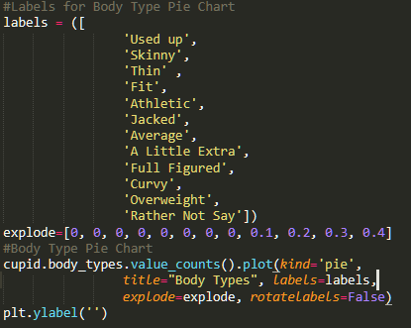
Exploring body types
The top picture is a pie chart of Users’ body types
From this we can gather
Most users are on the smaller side
A small portion of users, similar to our Offspring data (where few users specified to have offspring), have specified a heavier body type
Below is the code used to implement the Body Types pie chart
Similar to the Offspring bar graph, value counts from the new Body Types column were used to show the distribution of body types in our data
To make the data more readable, we used ‘explode’ to bring some slices further out
A labels map was created to show each body type

Slide 7
The question
Seeing the previous data, we began to look at the ~5,000 users who specified to have offspring. The question arose -
Using the data available, can we predict whether or not the user has offspring?

Slide 8

Creating the prediction model
To answer the previous question (Can we predict if the user has offspring?) we used two models:
The first model was the Linear Regression model
The weightings are based on our X data input into the Linear Regression function. In order with their weightings they are:
Age – (0.99374437)
Body Type – (0.14060331)
Relationship Status – (0.08595144)
Sexual Orientation – (-0.06589059)
Type of Job – (0.09618336)
The column that affected our model the most was age. Indicating certain age groups are more likely to have offspring than others. The second was Body Type!
But unfortunately our model was only 31.4% accurate and has a run time of
3.7 seconds.

Slide 9
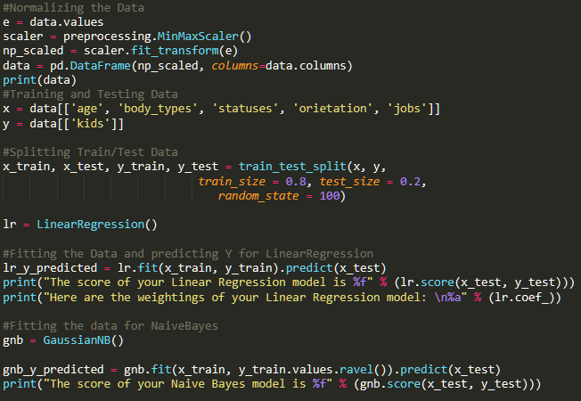
Creating the prediction model cont.
The second model we used was the Naïve Bayes model
Using the same data as with our Linear Regression model, the Naïve Bayes model not only increased our accuracy score to 84.39%, but it also had a faster run time by 0.2 seconds! Now that’s impressive.
Here you will see our model’s code side by side -

Slide 10
conclusion
To answer our initial question, can we predict whether or not the OKCupid user has offspring? The answer is yes. Using the Naïve Bayes classifier we were able to classify which users had offspring with nearly 85% success rate. The regression model didn’t quite make the cut, though.
Could we be more accurate, though? With a larger dataset it is very likely. The biggest problem was that most users did not input whether or not they had offspring, with only about half of the users specifying yes or no. With users being sure to fill out all criteria, it would be very possible for our classifier to be more accurate.

Slide 11
THE END

